Slide 1
Paper Simulations of Digital Games
Stone Librande
Lead Designer, Riot Games

Slide 2
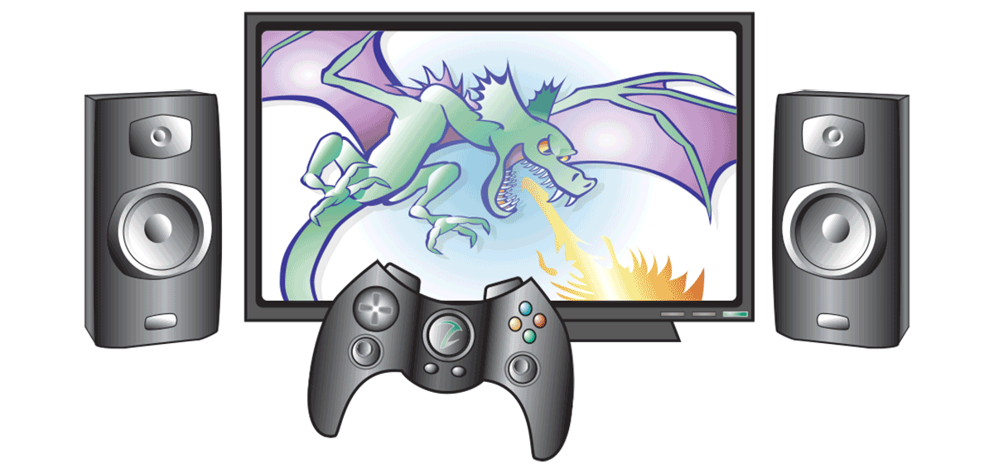
Take a digital game…

Slide 3
…remove the controller…

Slide 4
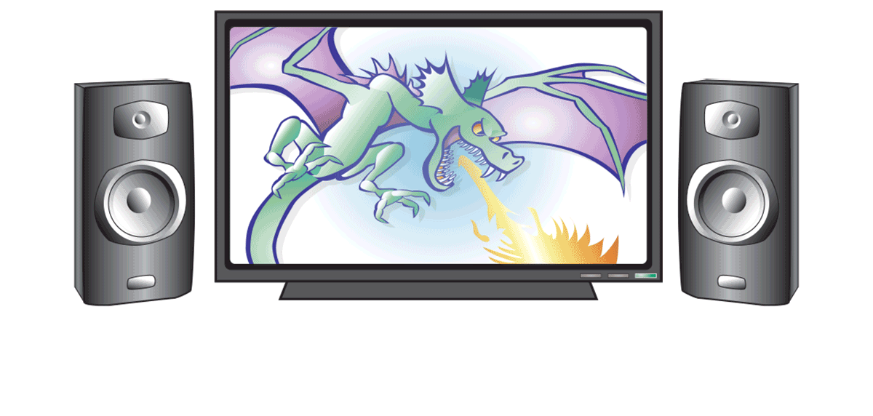
…remove the controller…

Slide 5
…the sound and music…

Slide 6
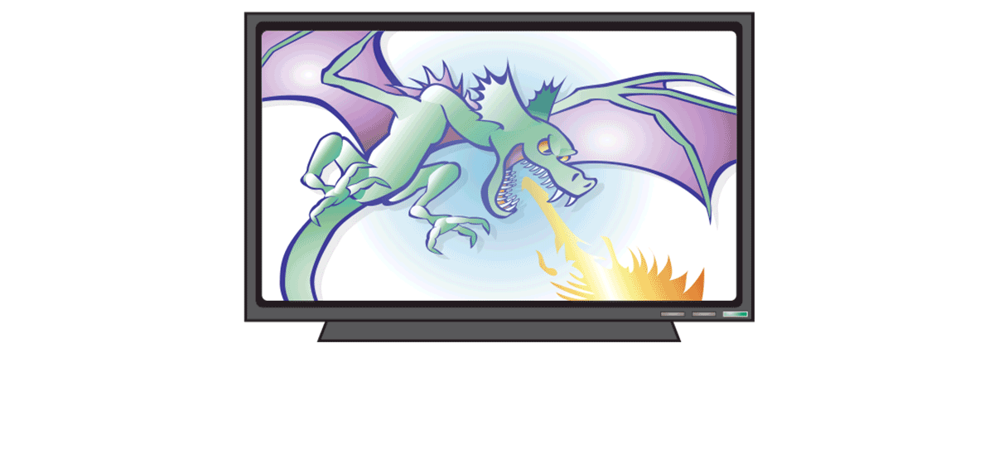
…the sound and music…

Slide 7
…and the graphics

Slide 8
…and the graphics

Slide 9
What’s left?

Slide 10
Paper Simulations of Digital Games
Simulate a video game using only pencils, index cards, markers and dice.
Use it as a tool to help understand the game’s fundamental design principles.
Try to capture the emotional experience.
Don’t focus on the tiny details.

Slide 11
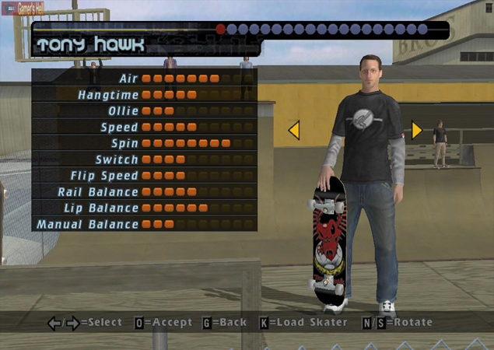
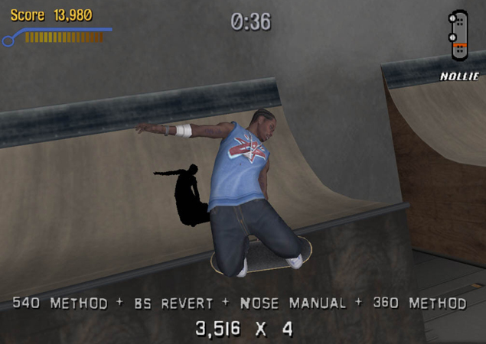
Example Game
Tony Hawk’s Pro Skater

Slide 12
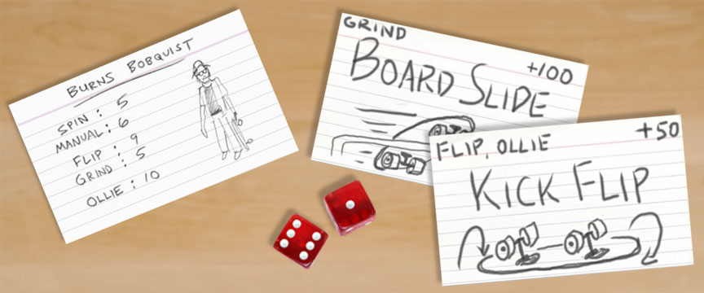
Example Game
Tony Hawk’s Pro Skater

Slide 13
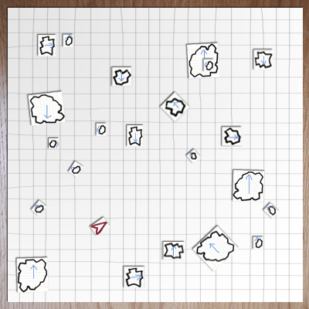
Asteroids

Slide 14
Asteroids

Slide 15
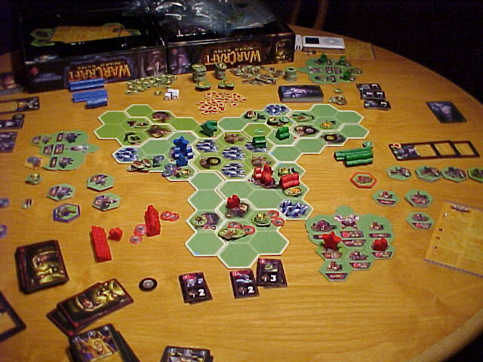
Warcraft III
The Board Game

Slide 16
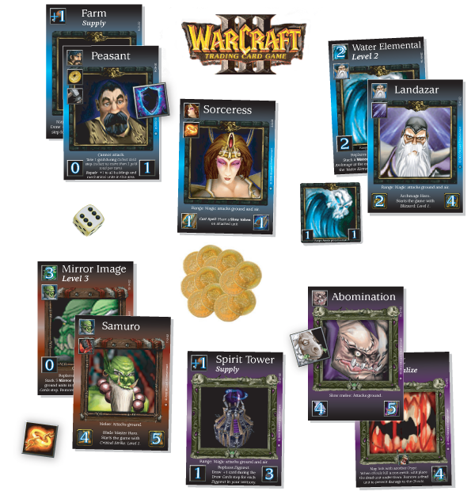
Warcraft III
The Card Game
Notes:
Warcraft card game
Headhunter example

Slide 17
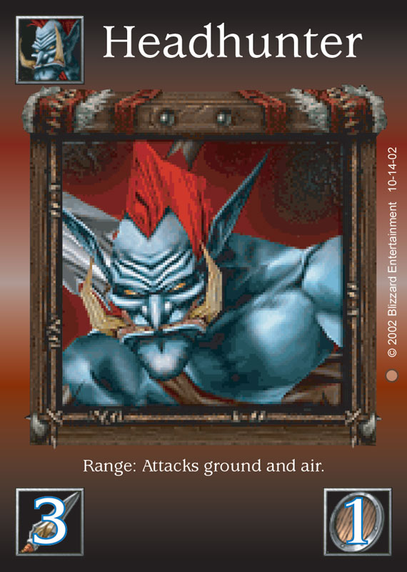
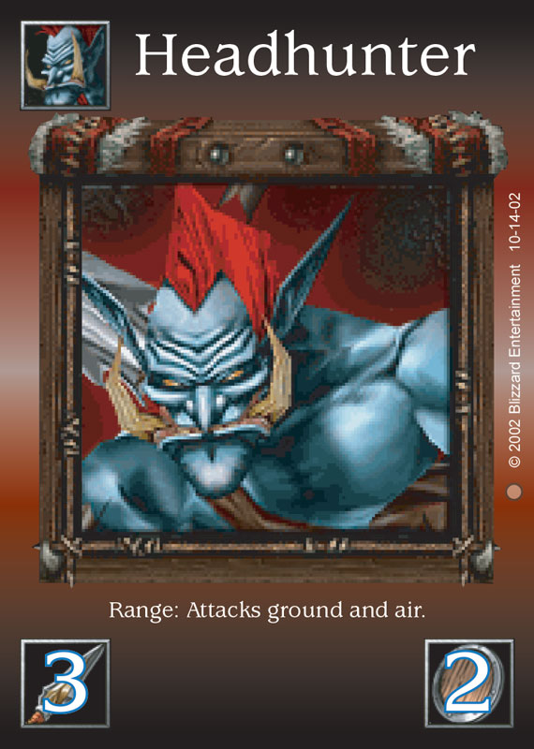

Slide 18
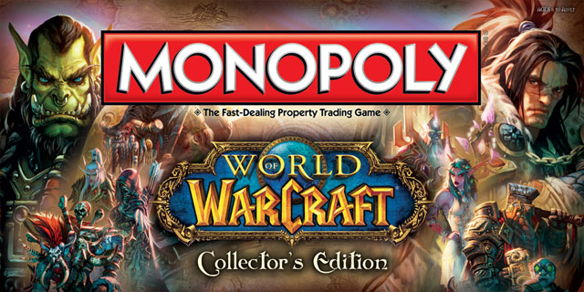

Slide 19
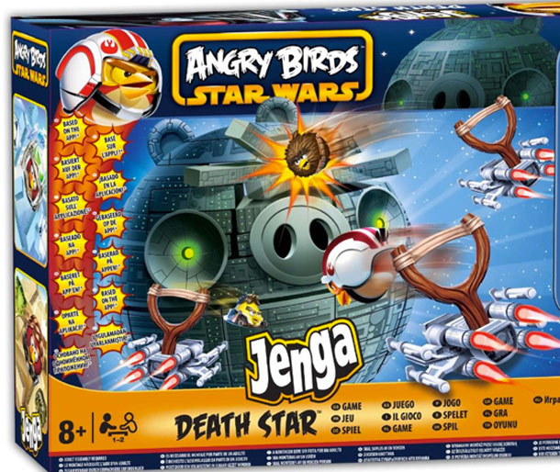

Slide 20
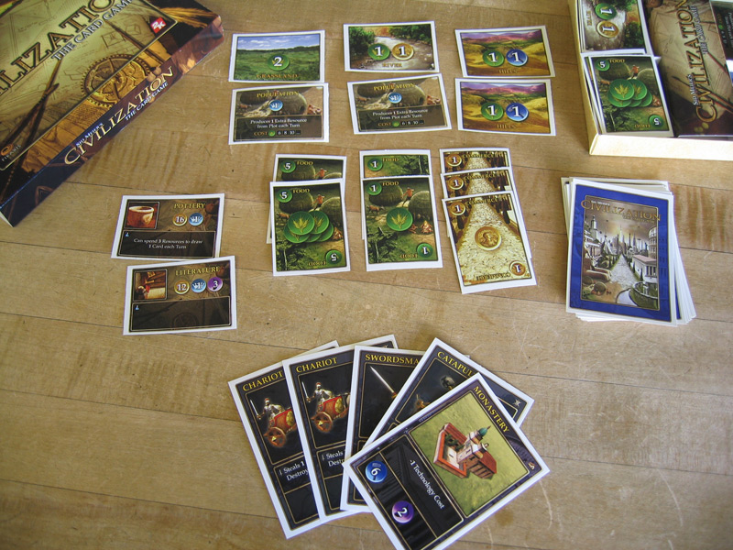
Civilization
The Card Game

Slide 21
Exercise
Select a digital game
Make a paper simulation
What aesthetics survive the change in medium?

Slide 22
Divide into Groups
Take your belongings and stand up against the wall.
Name a video game that you have played deeply.
Find 3-5 like-minded gamers and sit down at a table.
Share your experiences of the game with your teammates.

Slide 23
Capture Emotions
Discuss the emotions you feel when playing the game.
Pick one that you would like to try to capture.
Write down your choice and put it in the middle of your table.
Refer to it throughout the exercise.
“When I play this game I feel…”

Slide 24
Capture Actions
Discuss verbs that describe actions the player can take.
Pick a set that will be a good match for your emotion.
Write these down and put them near your emotion.
“Bounce” “Sell” “Reload” “Hide” “Swap” “Cook” “Capture”

Slide 25
Build a Paper Version
Quick Start:
Make cards with the actions written on them.
Discuss how to draw and play those cards in a way that makes the players feel your chosen emotion.
Is there randomness?
What choices do I have?
Are there any restrictions?
What state changes occur as the game progresses?

Slide 26
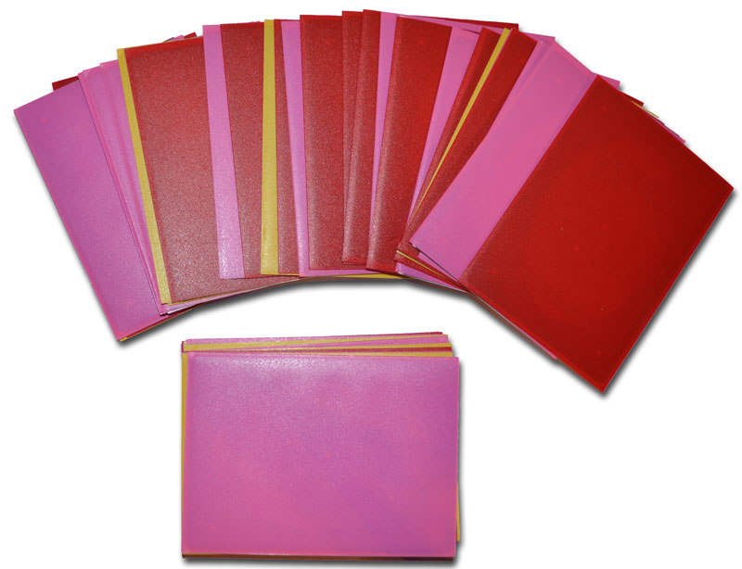
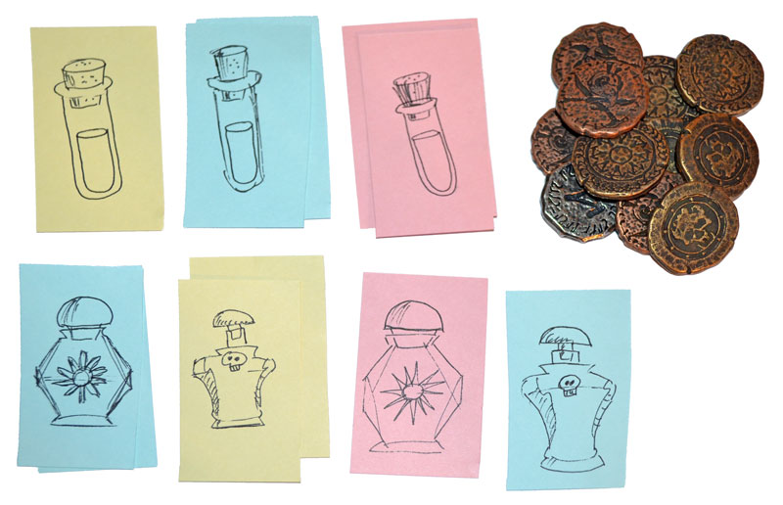
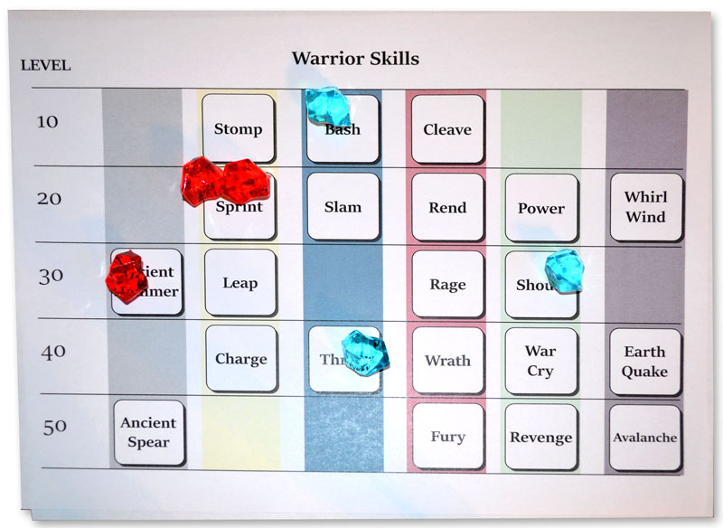
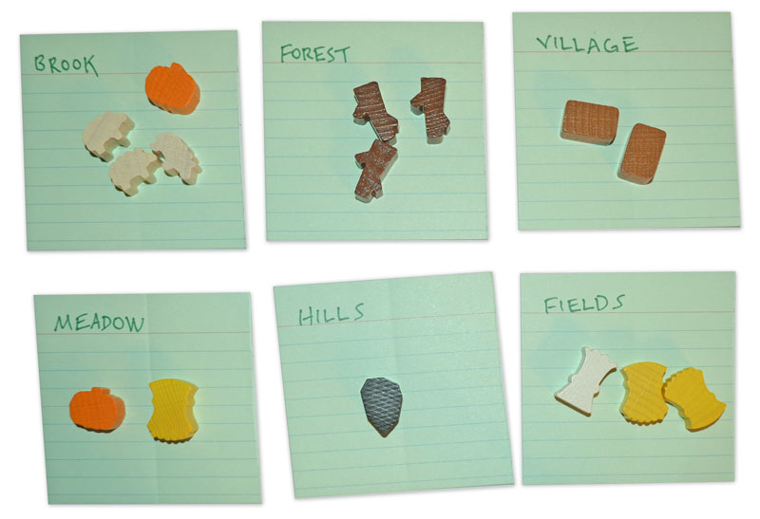
Build a Paper Version
Scope:
Single Idea
Session
Full Game
Metagame
Notes:
2. Scope
How much of the game will you be prototyping?
Single Idea
When you are trying to answer a specific question.
Example: “Which potions will players buy in the store? When do they restock?”
Session
Observing the type of decisions a player might make during a small portion of the game.
Example: “How will players develop their farm for the Fall season? What resources will be needed?”
Full Game
I warned you that it can be a mistake to try to duplicate the entire game. But it can be useful to select one system in your game and prototype how it plays out from the beginning to the end.
Example: “What paths can the player take as new skills become available? How will they use those skills to overcome the challenges they will face?”
Metagame
Determining the reward structures for long term engagement.
Example: “Which bonuses will players choose? How do their options change as new mechanics are unlocked?”

Slide 27
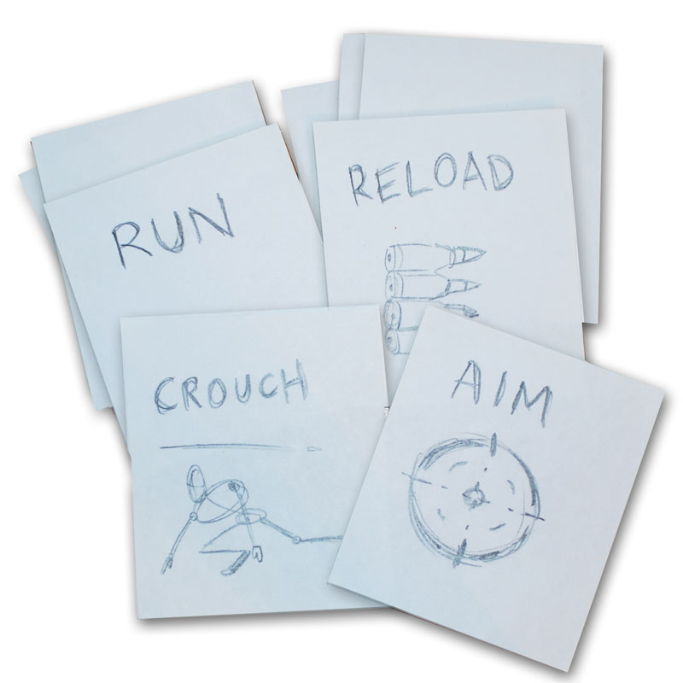
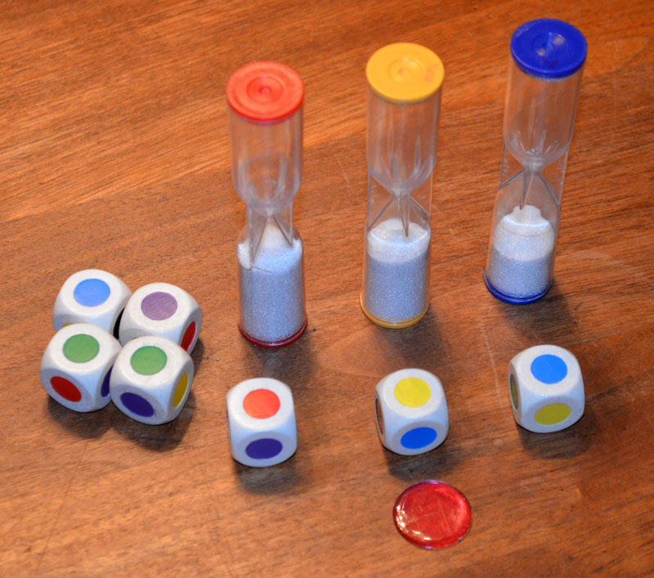
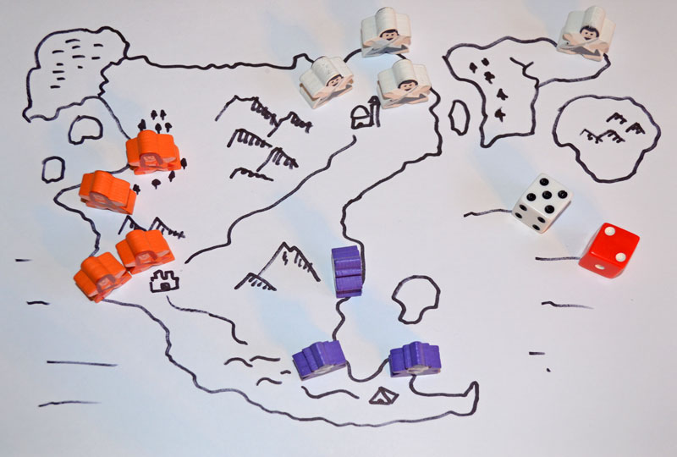
Build a Paper Version
Time Scale:
Slow
Real-time
Fast
Notes:
4. Time Scale
Slow
The paper prototype takes longer to play than the computer version. (This is common.)
Players have more time to make decisions.
Good for analyzing decision making processes. (It can simulate the “optimal player”; one who always makes perfectly informed decisions.)
Example: A card game that simulates combat choices in an FPS.
Real-time
The paper prototype takes the same amount of time as the computer version.
Good for analyzing player reaction and interaction possibilities.
How is a player’s decision quality affected by pressure?
Example: A matching game that uses a timer.
Fast
The paper prototype takes less time to play than the computer version.
Good for quickly simulating processes that may take many sessions.
Example: A tactical fighting game with armies. In the full game each battle may take 10 minutes, but in the paper prototype it is simulated by “high roll wins”. The purpose is to see how armies move across the continent, not to duplicate the combat experience.

Slide 28
Build a Paper Version
What not to do:
Don’t sweat the details (micro)
Don’t try to duplicate the whole game (macro)
Don’t focus on simulating computer functions
Don’t make a board!

Slide 29
Lunch Break at 12:00
Be back by 1:15
Stay in your same group
You are welcome to eat lunch in here
Read about electives on:
gdc.8kindsoffun.com or tinyurl.com/gdc-mda

Slide 30
How do we get from…
Cards
Dice
Rules

Slide 31
How do we get from…
to emotions?
Cards
Dice
Rules
Fear
Camaraderie
Surprise

Slide 32
What’s missing?
“Rules”
“Fun”

Slide 33
The causal link…
“Rules”
“Activity”
“Fun”
This is what sets games apart from other forms of entertainment

Slide 34
The MDA Framework
Mechanics
Dynamics
Aesthetics

Slide 35
Mechanics
The concepts and materials that create systems
Everything you need to play
Rules describing objects and interactions
Assembled into higher level systems

Slide 36
Dynamics
The run-time behavior of the game-as-system
Gameplay
The system in motion
Events that occur while playing

Slide 37
Aesthetics
The emotional player experience of the game
How players feel while playing
Not only visual or sensory qualities
Cognitive rather than Behavioral

Slide 38
The Designer/Player relationship


Mechanics
Dynamics
Aesthetics
Designer
Player

Slide 39
The Player’s perspective

Mechanics
Dynamics
Aesthetics
Player

Slide 40
The Designer’s perspective

Mechanics
Dynamics
Aesthetics
Designer

Slide 41
MDA Framework
A “taxonomy” of Design Knowledge
Mechanics
Dynamics
Aesthetics
…and the interactions between them.

Slide 42
Beta Test at 2:45
Test your game with other teams
Select two testers in your group
Send one to the table to the left…and one to the right
Teammates that stay will teach the game to others

Slide 43
Discussion
Did your paper game create the desired feelings?
What mechanics did you use to create those feelings?
Did you learn something new about the original game?
What would you add or change if you had more time?

Slide 44
Using Paper Prototypes
Good for understanding existing games.
Use these techniques for games in progress.
Process is quick and cheap.
You don’t need programmers or artists.

Slide 45
Using Paper Prototypes
Can’t replace actual gameplay testing.
Can give you a head start and keep you focused.
Creates a vocabulary to use when discussing your game.
Can be used as a tool to educate other team members. Have them play, too!

Slide 46
Short Break
Electives start at 3:35
Elective
Room
Feelin’ GRUVI
206
MDA in Action: Us vs. It
207
Escape Room Jam
208
Game of Games
215
Horns of a Dilemma
216

